Slide 1
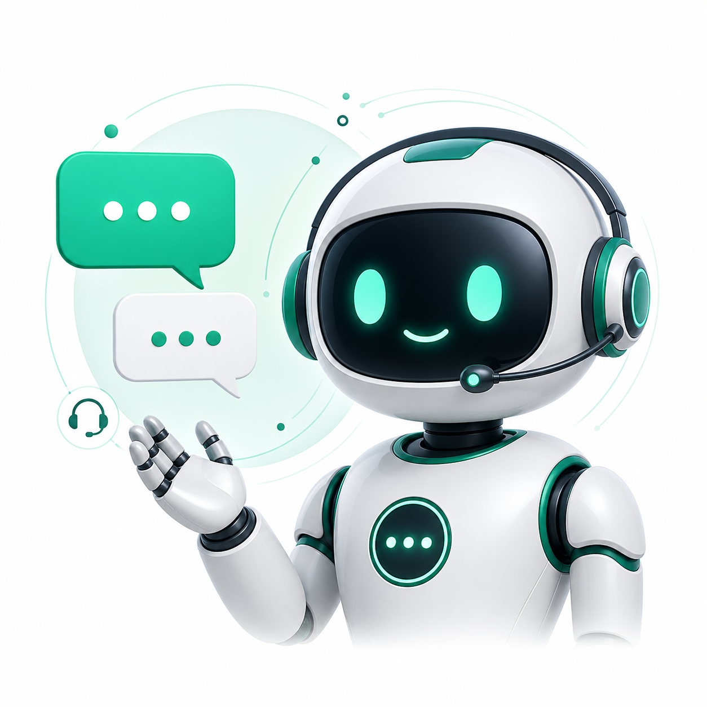
Intelligent Customer Support System
Using NLP, Chatbots & Explainable AI with Transparent Confidence Scoring
A support assistant that detects user intent, checks real database records, shows confidence, explains reasoning, and escalates to humans when needed.
Team Members
Anjana Vaidyula — Project Manager
Suraj Reddy Kota — Project Technical Manager
Akshaya Bollikonda — Project Design Manager
Sai Abhiram Goud Seekati — Configuration Manager
1

Slide 2
Problem Statement
02
Why current customer support chatbots need more transparency and data grounding
1
Black-Box Responses
2
No Confidence Visibility
Most bots answer without showing why the answer was chosen, so users cannot judge if it is reliable.
The user sees a message, but not whether the bot is 95% sure or only guessing with low certainty.
3
Generic Canned Replies
4
Delayed Human Handoff
Traditional flows often rely on fixed templates instead of checking live order, transaction, or subscription data.
Users are usually transferred to an agent only after repeated failed steps, which increases frustration.
2

Slide 3
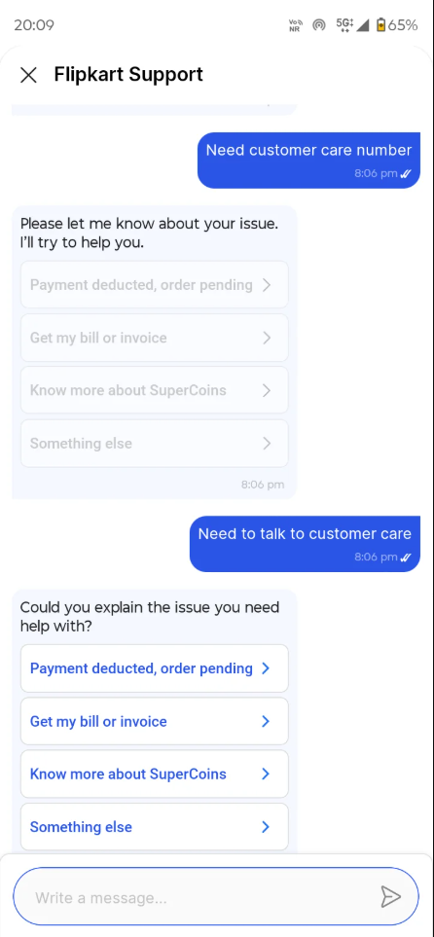
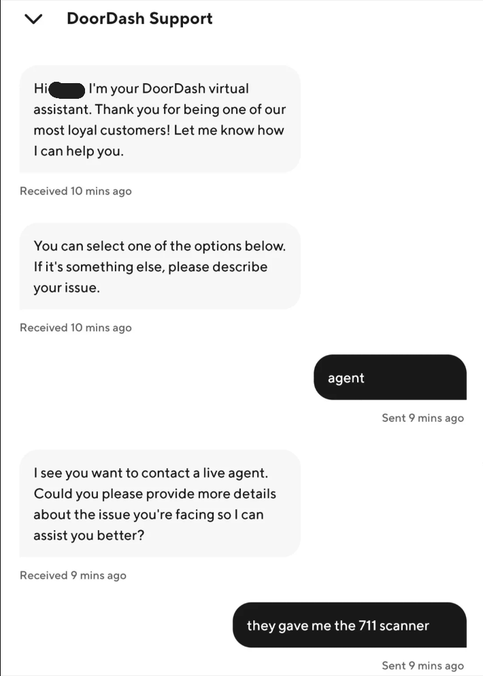
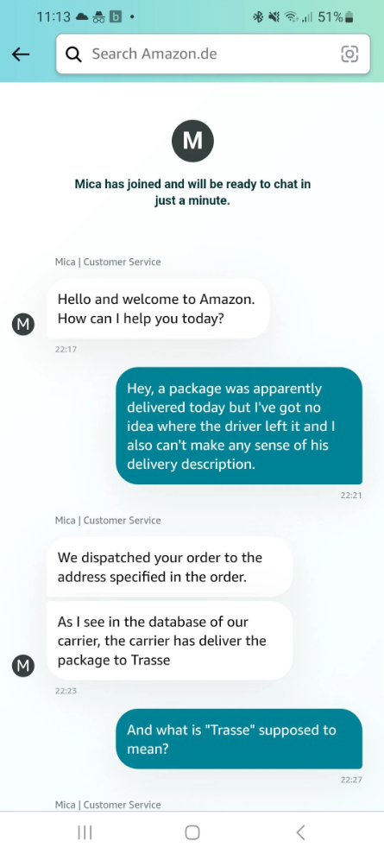
Existing Systems: Real Retail Support Chatbots
03
Reference examples from big support systems such as Amazon, DoorDash, and Flipkart
DoorDash Support
Amazon Support
Flipkart Support
Asks for issue details; live agent path exists but can still require repeated explanation.
Uses support agents and database checks, but user does not see confidence or reasoning.
Guides users through menu-style support options before free-text resolution.
3

Slide 4
Existing Systems vs Our System
04
Clear gap analysis and how our project improves transparency
Feature
Traditional Chatbots
Our System
Confidence Score
Usually hidden from user
0–100% confidence visible
Explainability
Black-box answer flow
Shows intent, sentiment, DB source
Response Source
Templates or agent scripts
Database-verified response
Personalization
Low to medium
Uses customer/order/subscription records
Human Handoff
Reactive after failures
Proactive when risk is high
User Trust
Depends on repeated interaction
Improved by visible reasoning
Main improvement: our system does not only reply; it explains confidence, verifies data, and decides when human support is safer.
4

Slide 5
Four Core Pillars of Our Solution
05
The design focus that makes the chatbot trustworthy and practical
1
Transparent Confidence Scoring
2
Database-Verified Responses
Every response includes a 0–100% score so the user can understand whether the answer is verified, uncertain, or risky.
The bot checks customer, order, transaction, and subscription records before giving a factual answer.
3
Explainable AI (XAI)
4
Proactive Human Handoff
The interface shows detected intent, sentiment, trigger words, queried tables, and response source.
The system recommends an agent when confidence is low, frustration is high, or an ID is missing.
5

Slide 6
System Architecture
06
End-to-end flow from customer query to transparent answer
React Frontend
Flask Backend API
NLP / AI Engine
PostgreSQL DB
Final Response
Customer chat UI
Confidence display
XAI explanation panel
→
Routes requests
Controls business logic
Connects services
→
Intent classification
Sentiment analysis
Response generation
→
Customers
Orders
Transactions
Subscriptions
→
Verified answer
Confidence score
Handoff decision
Architecture Explanation
The system follows a pipeline design: the frontend collects the query, Flask manages processing, AI/NLP detects meaning and tone, PostgreSQL verifies real records, and the final answer returns with confidence and explanation.
6

Slide 7
AI Models Used in the Project
07
Where AI is actually used and how it supports the chatbot behavior
1. Large Language Model (LLM)
2. Transformer / NLP Models
LLaMA 3.1 Instruct is used as the main response-generation model.
It converts the verified context into a natural, helpful customer-support reply.
The model is accessed through an OpenAI-compatible API layer.
It is not used alone; the answer is controlled by intent, confidence, and database checks.
RoBERTa-style sentiment model identifies positive, neutral, or negative tone.
DistilBART / transformer classifier supports intent detection and fallback classification.
Keyword and rule-based logic supports ID extraction and sub-intent detection.
These models help the system decide whether to answer, ask follow-up, or hand off.
7

Slide 8
NLP Pipeline
08
How a customer message becomes a support decision
1
Input Message
2
Preprocessing
Customer types a free-text issue such as refund, delivery, billing, or account problem.
Text is normalized, cleaned, tokenized, and prepared for classification.
3
Intent Classification
4
Sentiment Analysis
The system predicts the main support category and sub-intent.
Tone is evaluated to detect frustration, urgency, or positive/neutral feedback.
5
ID Extraction
6
Decision Output
Order ID, customer ID, transaction ID, or subscription ID is detected using patterns.
The system returns answer, confidence, explanation, and handoff recommendation.
8

Slide 9
Sentiment Score: Groups and Formula
09
Reasonable explanation for how sentiment is selected and weighted
Sentiment Groups
Formula Used
Positive: happy, resolved, thank you, satisfied, working.
Negative: angry, late, broken, charged twice, refund, not received.
Neutral: basic tracking, account info, greeting, general question.
Negators: not, never, no, don’t — reverse or reduce sentiment meaning.
Intensifiers: very, extremely, urgent — increase emotion strength.
Sentiment Score = (Positive Strength − Negative Strength) / Total Signal
Score greater than +0.20 → Positive sentiment.
Score between −0.20 and +0.20 → Neutral sentiment.
Score less than −0.20 → Negative sentiment.
Frustration intensity above 0.60 can trigger human handoff.
Sentiment is weighted 15% because it affects urgency and tone, but database verification is more important for factual accuracy.
9

Slide 10
Transparent Confidence Scoring
10
How the system decides if an answer is reliable enough
Final Confidence = 0.20(Intent Match) + 0.10(Intent Clarity) + 0.15(Query Specificity) + 0.15(Sentiment Alignment) + 0.40(Data Verification)
20%
10%
15%
15%
40%
Intent Match
Intent Clarity
Query Specificity
Sentiment Alignment
Data Verification
Checks how strongly the query matches one support category.
Penalizes ambiguity when multiple intents are close.
Detailed queries give more evidence, but long text is not over-rewarded.
Checks whether emotion and issue type make sense together.
Highest weight because a verified database record makes the answer trustworthy.
Reason for weights: Intent tells what the user wants, but data verification decides whether the bot can safely answer with facts.
10

Slide 11
Confidence Levels and Human Handoff
11
Making automation safe instead of forcing low-quality answers
HIGH
MEDIUM
LOW
VERY LOW
75–100%
50–74%
30–49%
0–29%
Answer is verified and reliable.
Helpful but may need extra detail.
Limited confidence or missing data.
Risky or unsupported answer.
Auto-answer with explanation.
Answer + ask clarifying question.
Offer agent handoff.
Recommend human agent.
Human Handoff Triggers
Confidence drops below the safe threshold.
User frustration intensity becomes high.
Provided order, transaction, customer, or subscription ID is not found.
The issue is sensitive, financial, or cannot be verified from available records.
11

Slide 12
Database Integration and Genuine Responses
12
Why this project gives more than generic chatbot replies
Data Entities Used
Verification Flow
Customers
Profile and account details
1
Step 1
Extract useful identifiers from the user message.
Orders
Status, delivery, item history
Step 2
2
Transactions
Payment and refund records
Query the correct database table based on detected intent.
3
Step 3
Subscriptions
Plan, renewal, cancellation info
Build the reply using the retrieved record and status.
4
Step 4
Interactions
Conversation logs and outcomes
If record is missing, reduce confidence and recommend escalation.
12

Slide 13
Explainable AI Output
13
What the system shows to make the answer understandable
Example Explanation Panel
Why this impresses in demo
Predicted Intent
Refund / Billing Issue
The user can see why the bot made a decision.
The support agent receives useful context before taking over.
Developers can debug wrong predictions by checking intent, sentiment, and DB source.
This directly addresses the black-box limitation of many existing chatbots.
It makes AI behavior measurable instead of only conversational.
Sentiment Label
Negative, frustration = 0.68
Confidence Score
62% — Medium
Key Signals
charged twice, refund, order ID
Database Source
transactions + orders table
Recommended Action
Provide answer + offer agent option
13

Slide 14
Demo Scenario: Refund or Billing Issue
14
How the system behaves in a realistic support conversation
User: “I was charged twice. Can I get a refund?”
Expected Bot Response
I found the transaction linked to your account. The system detected a possible billing/refund issue. Your request has medium confidence because the transaction is available, but refund approval requires confirmation. I can guide you through the next step or connect you with an agent.
1
Intent Prediction
refund / billing issue
2
Sentiment Detection
negative + urgency
Why this is better:
3
Database Lookup
The reply is not random or generic.
It is backed by intent, sentiment, and database context.
The user is offered a human option when financial risk exists.
transactions and orders checked
4
Confidence Score
medium/high if payment record is found
5
Response + Handoff
answer with next step and agent option
14

Slide 15
Conclusion and Key Takeaways
15
Why the project is practical, transparent, and useful for real support systems
Key Takeaways
Final Message
The system improves over traditional chatbots by showing confidence instead of hiding uncertainty.
AI is used for intent detection, sentiment analysis, response generation, and support decision-making.
Database verification makes responses more factual and personalized than generic templates.
Explainable AI helps customers, support agents, and developers understand each decision.
Human handoff keeps the system safe when confidence is low or the issue is sensitive.
Our project goes beyond a normal chatbot. It combines NLP, LLM-based response generation, real-time database verification, transparent confidence scoring, sentiment analysis, XAI, and proactive human handoff to create a trustworthy customer support assistant.
Thank You
15

